Slide 1

Philosophical Progress and Improvement Across Time
by Cameron Fen

Slide 2
The Debate Over Progress in Philosophy
Skeptical View
Evidence of Progress
Some argue philosophy has made no real progress, only changes in opinion. This view is especially prevalent in qualitative fields like the humanities.
However, new tools in machine learning and natural language processing now allow us to quantify and measure suggestive evidence of progress in previously qualitative fields like philosophy.

Slide 3

Conditions for Improvement Over Time
1
Better Ideas Adopted
2
Finding New Ideas
Ideas that are more likely to be good are more likely to be adopted than ideas that are less good.
In a field with progress, new ideas are more likely to come from undiscovered areas, rather than areas where previous books have been written

Slide 4




Examples of Progress in
Movies
Basketball
Improved storytelling techniques and formulas for engaging audiences
Better preparation, skills, athleticism, and strategies
Logic
Modern analytic philosophy addressing flaws in older logical systems

Slide 5


Methodology: Text Embeddings
Vector Representation
Semantic Understanding
Text embeddings map words, sentences, or paragraphs into vectors that represent their meaning.
Vectors that are closer to one another have similar meaning, allowing quantitative analysis of text.

Slide 6
Text Embeddings
Machine Understanding of Text Meaning
Tried and True Method
For example, the vector for “king” minus “man” plus “woman” is close to the vector for “queen”
Two of the seminal papers in the field, word2vec and BERT have a total of 150,000 citations
Jina AI Model
We use the Jina AI embedding model to convert philosophical texts into 32-dimensional vectors and then measure the distance between different texts and examine trends over time

Slide 7
Data Visualization: UMAP
Dimensionality Reduction
Topological Structure
We use UMAP to reduce the 32-dimensional embeddings to 2D for visualization purposes.
UMAP maintains the topological structure, keeping clustered points together and outliers separate.

Slide 8
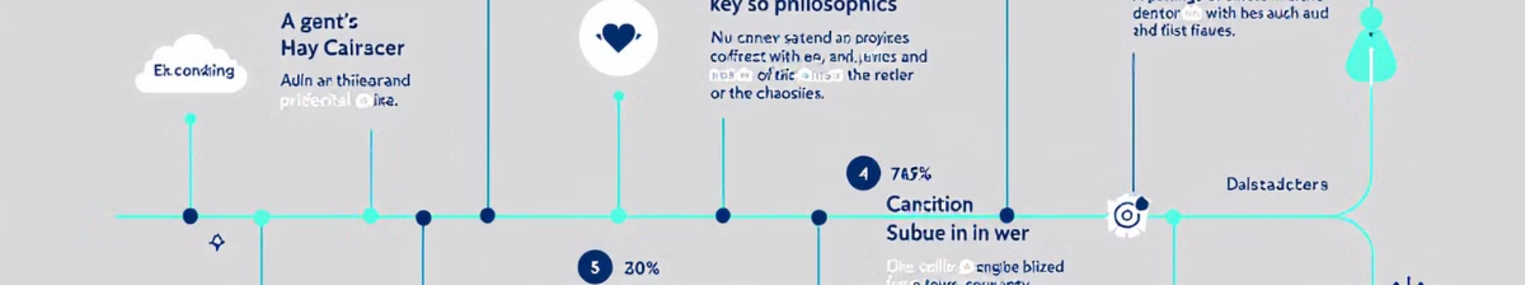



Directionality in Philosophical Progress
Ancient Texts
Gradual Shift
Modern Texts
Embeddings of ancient philosophical texts cluster together
Embeddings show a gradual shift in content and style over time
Modern philosophical texts cluster further away from ancient texts

Slide 9
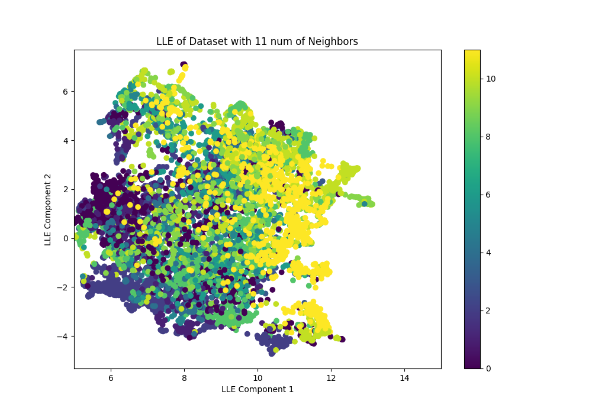
Evidence of Progress: Directionality
Consistent Trend
Not Random
Visualization shows a consistent trend of philosophical texts moving away from ancient works over time.
This directionality suggests, at least, a preference for novelty and directionality rather than random changes in taste.
Lower/darker numbers are older, starting with ancient Greece and ending in the early 1970s.
Building on Insights
Argue, new philosophy builds on accepted insights, moving further from ancient texts as new knowledge accumulates.

Slide 10
Statistical Analysis: Distance from Ancient Philosophy
Cross Distance
Wasserstein-2 Distance
We measure the average distance between every point in a time period cluster to every point in the ancient philosophy cluster.
We also use the entropic regularized Wasserstein-2 distance between clusters, based on optimal transport theory.

Slide 11

Results: Increasing Distance from Ancient Philosophy
Both distance metrics show a trend of increasing distance from ancient philosophy over time, suggesting consistent progress and movement away from historical texts.

Slide 12

Statistical Significance
Regression Analysis
P-values
Cross distance: p < 0.01, Wasserstein-2 distance: p = 0.012
Regression of distance on time shows statistically significant positive trend.
Non-stationarity
KPSS test suggests non-stationarity, indicating consistent movement away from ancient philosophy.

Slide 13
Analytic vs Continental Philosophy
Analytic Philosophy
Continental Philosophy
Comparison
Often considered more "scientific" and precise in its approach to philosophical questions.
Typically more interpretive and focused on broader cultural and historical contexts.
Both show similar distances from ancient philosophy, suggesting progress is not unique to analytic approaches.

Slide 14
Distance from Ancient Philosophy by Field

Slide 15
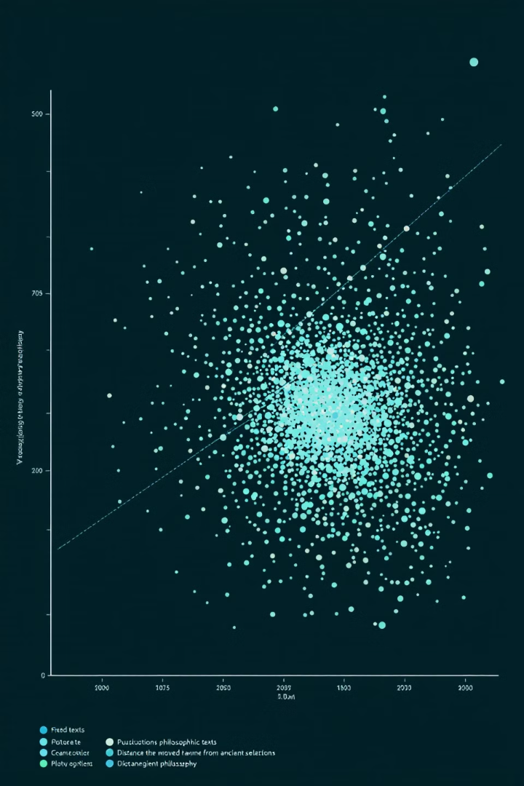
Interpretation of Distance Results
Similar Progress
Time vs Topic
Analytic and Continental philosophy show similar distances from ancient texts, suggesting comparable progress.
Date appears more important than topic in determining distance, indicating systematic progress across philosophy.
Exceptions
Some fields like Pre-Existentialism show temporary retreats, but overall trend continues.

Slide 16
Evidence of Specialization
Increasing Difficulty
Measurement
As general insights become established, novel insights require deeper understanding of specialized niches.
We calculate the standard deviation of each embedding dimension over time to measure specialization.

Slide 17

Results: Increasing Specialization
The graph shows a general trend of increasing standard deviation in embedding vectors over time, suggesting philosophical texts are becoming more specialized and distinct from one another.

Slide 18
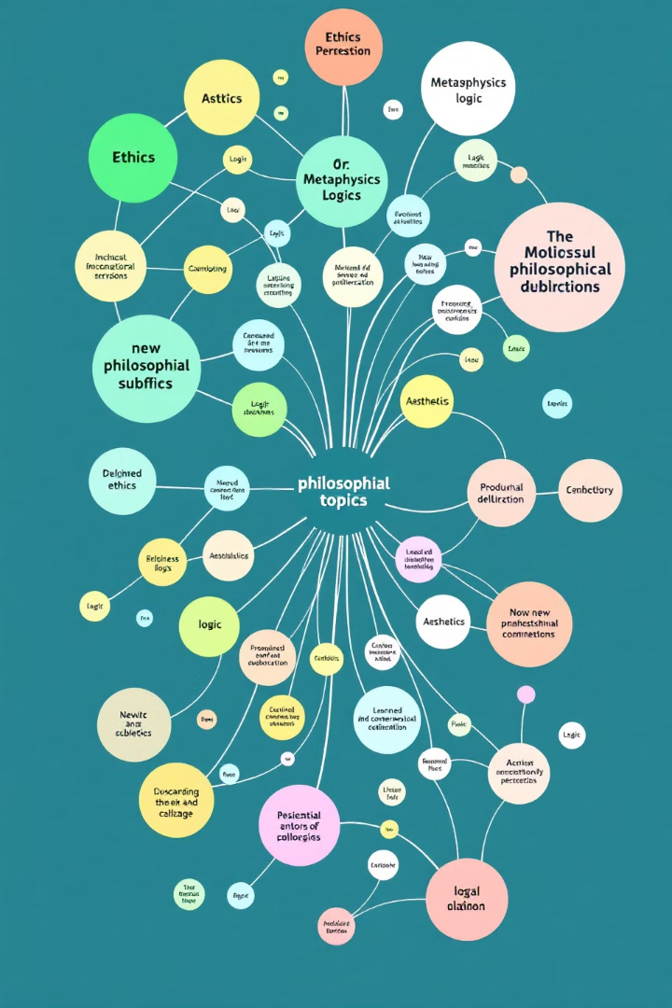
Interpretation of Specialization Results
Evidence of Progress
Consistent with Other Fields
Increasing specialization suggests agreement on general principles and the need for deeper, specialized knowledge.
This trend is consistent with specialization observed in scientific fields that show clear progress.
Challenges Random Taste Theory
Specialization is difficult to explain if changes in philosophical focus are due to random preferences.

Slide 19

Limitations and Future Work
Embedding Limitations
Sample Size
Other Humanities Fields
Expanding the dataset to include more texts could provide more robust results.
Text embeddings may not capture all nuances of philosophical arguments.
Applying similar analysis to other humanities disciplines could yield interesting comparisons.

Slide 20

Broader Implications for the Humanities
Quantitative Analysis
Bridging Disciplines
Challenging Relativism
This approach demonstrates the value of applying scientific methods to humanistic inquiry.
Similar methods could be applied to other humanities fields to measure progress and evolution of ideas.
Evidence of progress in philosophy challenges extreme relativist positions in the humanities.

Slide 21

Conclusion: Evidence of Philosophical Progress
Directional Movement
Increasing Specialization
Consistent trend of philosophical texts moving away from ancient works over time.
Growing complexity and specialization in philosophical topics.
Measurable Advances
Quantitative evidence of progress in a traditionally qualitative field.

